Slide 1

Team: OLD482
Traffic Object/Lane Detection
Project Proposal
Notes:
Jason

Slide 2
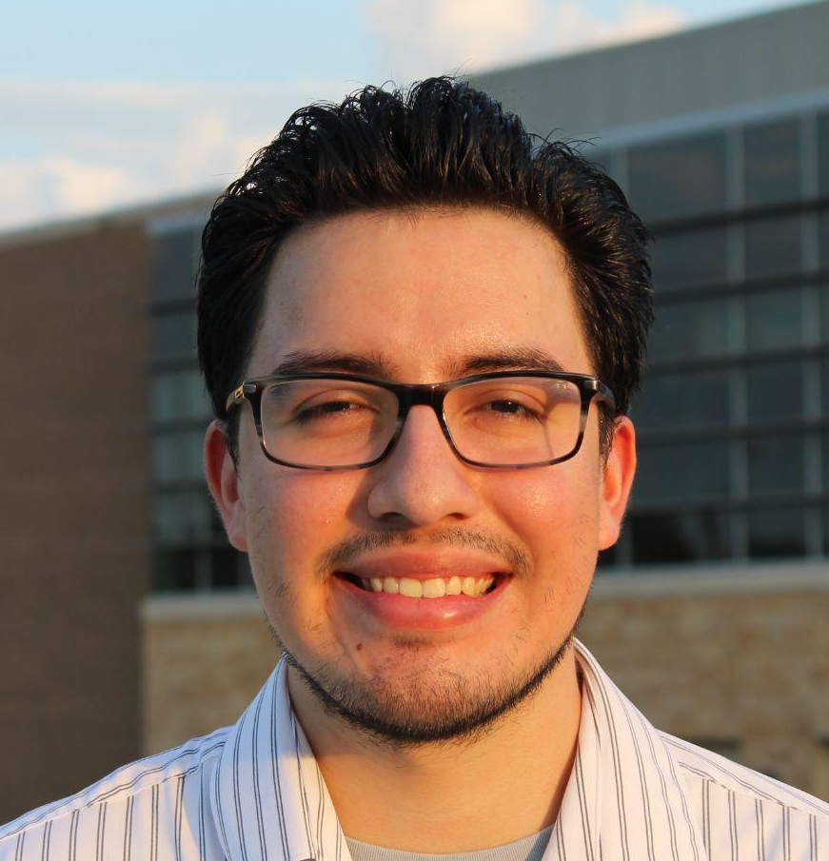





Jason Bernal
Pavan Poladi
Khai Nguyen
Viet Nguyen
Notes:
Jason

Slide 3
1
Problem Background
Notes:
Pavan

Slide 4
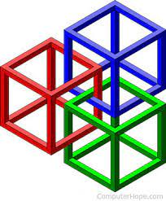


Frameworks:
ROS: Separate lane & object detection models
Hybrid Nets: Joint detection models
New Pipeline:
Images -> ROS -> Hybrid Nets -> ROS
Comparisons:
Accuracy & Speed
Usability & Robustness
Notes:
Pavan

Slide 5
2
Needs Statement
Notes:
Pavan

Slide 6
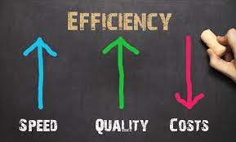
Need: We need to make ROS’ use of object and lane detection more efficient, accurate, and intuitive.
Why:
Users of ROS can have more smooth, simple, and confident experience.
Improve ability for ROS to make future improvements
Notes:
Pavan

Slide 7
3
Goal and Objectives
Notes:
Pavan

Slide 8
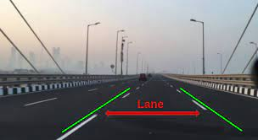
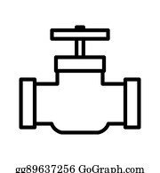
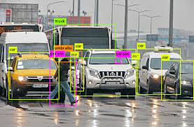
Goal: Create a clear and flexible pipeline allowing ROS to integrate an existing combined lane and object detection framework.
Why:
Eliminates need to run two separate detection models
Frameworks like Hybrid Nets are more fast and accurate
Notes:
Pavan

Slide 9

Objectives
Fully understand the ROS framework
Test ROS’ current lane and object detection models
Test Hybrid Nets’ joint detection model
Compare Ros and Hybrid Net detection models
Create pipeline To integrate Hybrid Net into ROS
Notes:
Pavan

Slide 10
4
Design Constraints & Feasibility
Notes:
Pavan

Slide 11
Technical:
Little experience/knowledge working with ML & Graphs
No previous exposure to ROS or detection frameworks
Temporal:
10 total weeks to start and finish project
Limited time to get familiar with ROS and create CDR & Final Presentation
Physical:
Performance capabilities of our laptops
4 total team members
Economic:
Have zero additional spending using free frameworks
Notes:
Pavan

Slide 12
5
Literature Review
Notes:
Khai

Slide 13


Papers
Project 1: Study of object detection based on Faster R-CNN
Project 2: EfficientDet: Scalable and Efficient Object Detection
Project 3: Flexible lane detection using CNNs
Project 4: YOLOPv2: Better, Faster, Stronger for Panoptic Driving Perception
Project 5: A Clustering Method Based on K-Means Algorithm
Notes:
Khai

Slide 14
6
Evaluation of Alternative Solutions
Notes:
Viet

Slide 15

Alternative solutions
Notes:
Viet

Slide 16



Alternative solutions cont.
Ground up
Brute Force
Fall back
Notes:
Viet

Slide 17
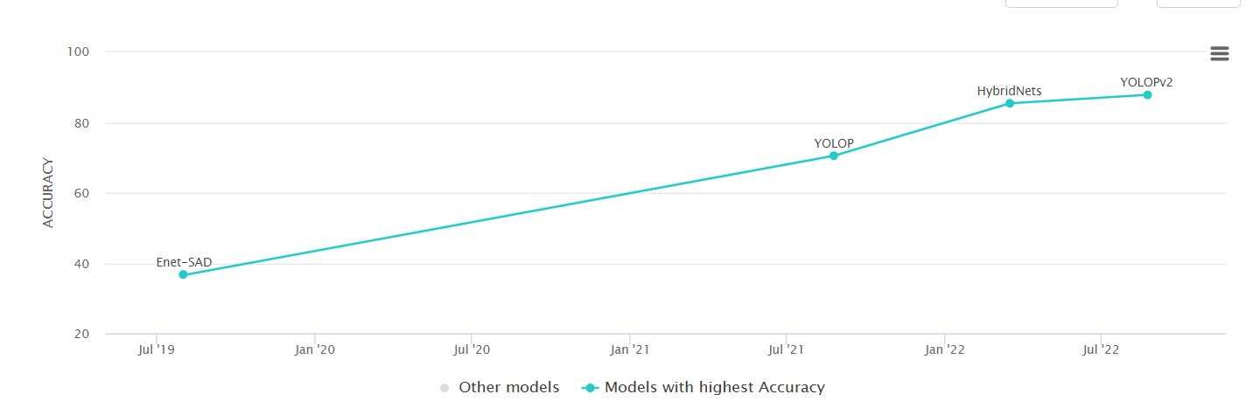
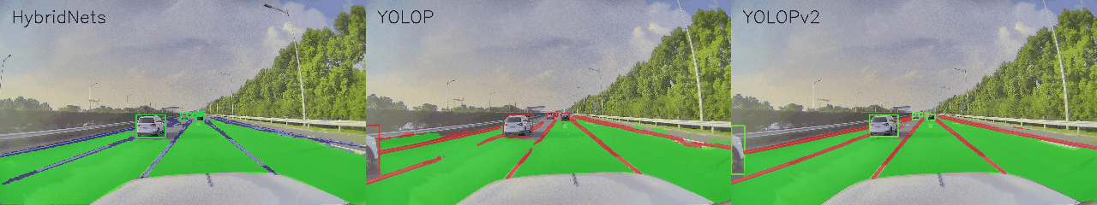
Last Alternative : YoloPv2
Notes:
Viet

Slide 18
7
Proposed Design
Notes:
Khai

Slide 19
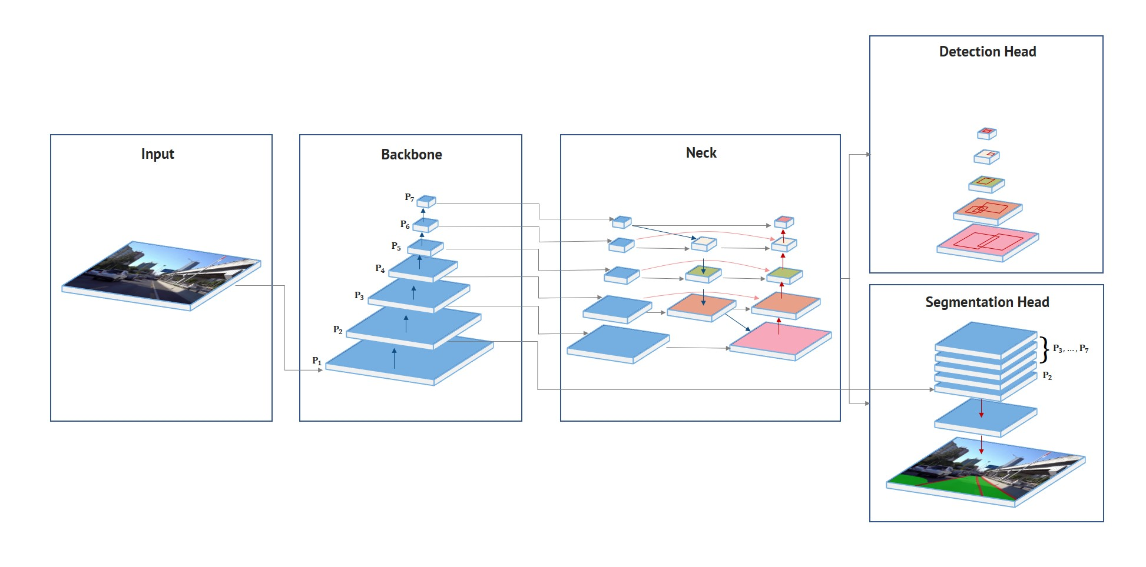
Part I - Machine Learning Framework
Notes:
Khai

Slide 20
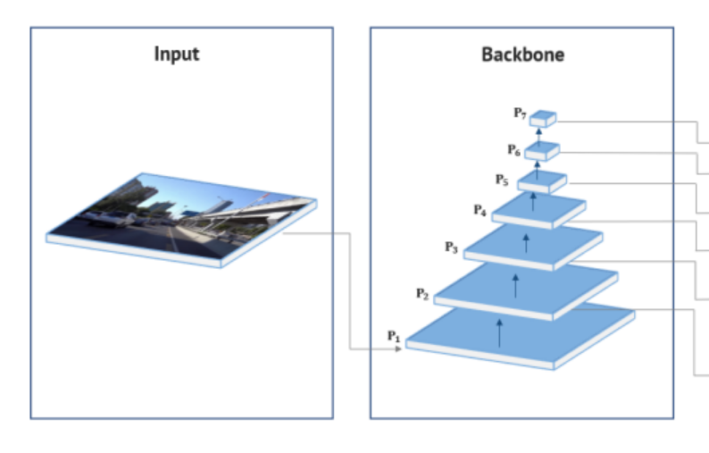
Backbone - extracting features
EfficientNet - B3
(5,3)
(640/2^2), (384/2^2) = (160,96)
(640, 384)
Export feature maps
Notes:
Khai

Slide 21
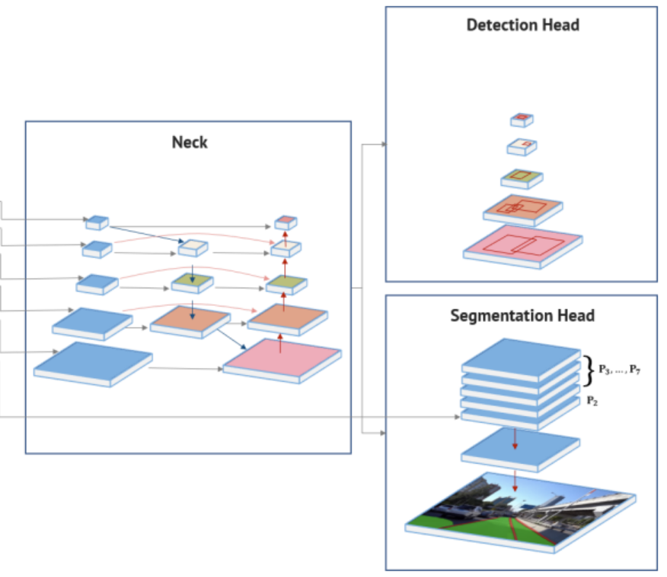
BiFPN
Fuse features with different resolution
Reuse K-means anchor clustering from YOLOv4
Notes:
Khai

Slide 22
Background, drivable area, and the lane lines.
Notes:
Khai

Slide 23
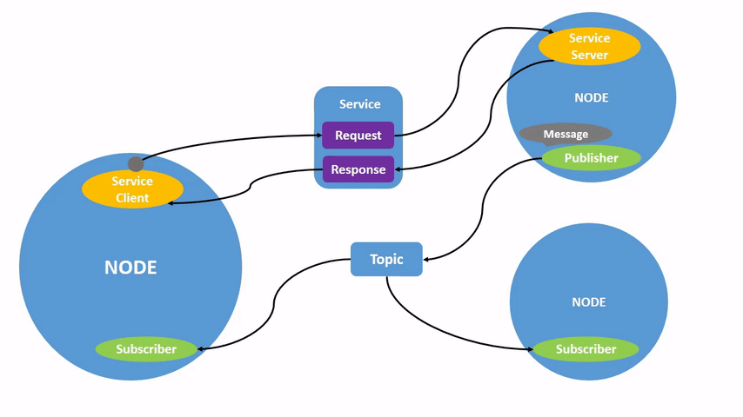
ROS Architecture - Overview
Nodes enable Modularity
Each Node serves a single Process/Purpose
Communication between nodes use a Interprocess Communication (IPC) method
Notes:
Jason
Source: https://docs.ros.org/en/foxy/Tutorials/Beginner-CLI-Tools/Understanding-ROS2-Nodes/Understanding-ROS2-Nodes.html

Slide 24
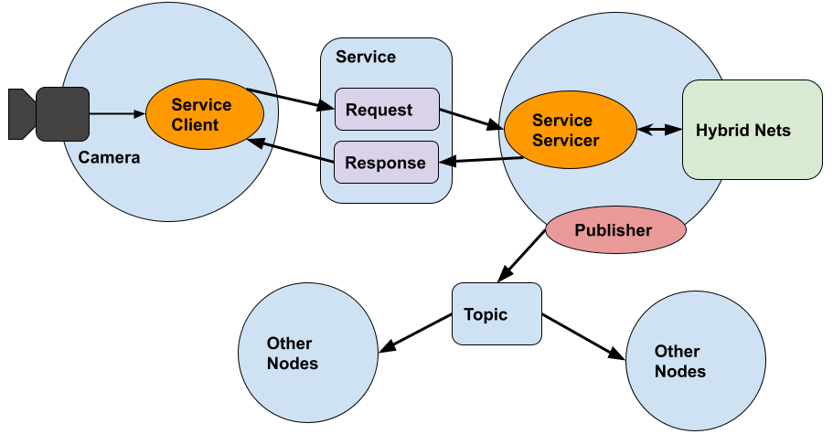
Part II - ROS Design Implementation
Integrate Existing Machine Learning (ML) Framework into ROS Node
Communicate Camera Input to ML Framework
Output ML Results to Appropriate Nodes
Notes:
Jason
maybe Viet for picture

Slide 25
8
Approach for Design Validation
Notes:
Pavan

Slide 26
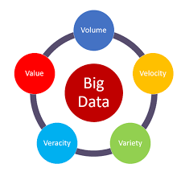

Validation 1:
Ensure we have made accurate & Robust comparisons
Use following datasets:
Included in ROS
Included in Hybrid Net
Provided by Instructor
Online
Compare at least:
Speed (Most important)
Accuracy
Notes:
Pavan

Slide 27
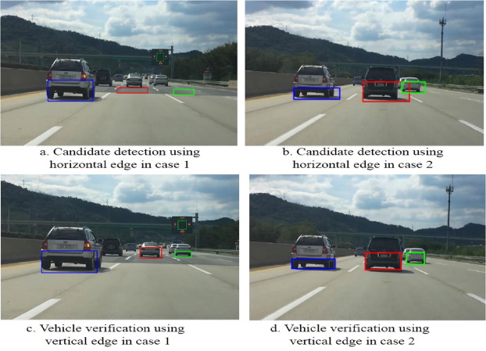
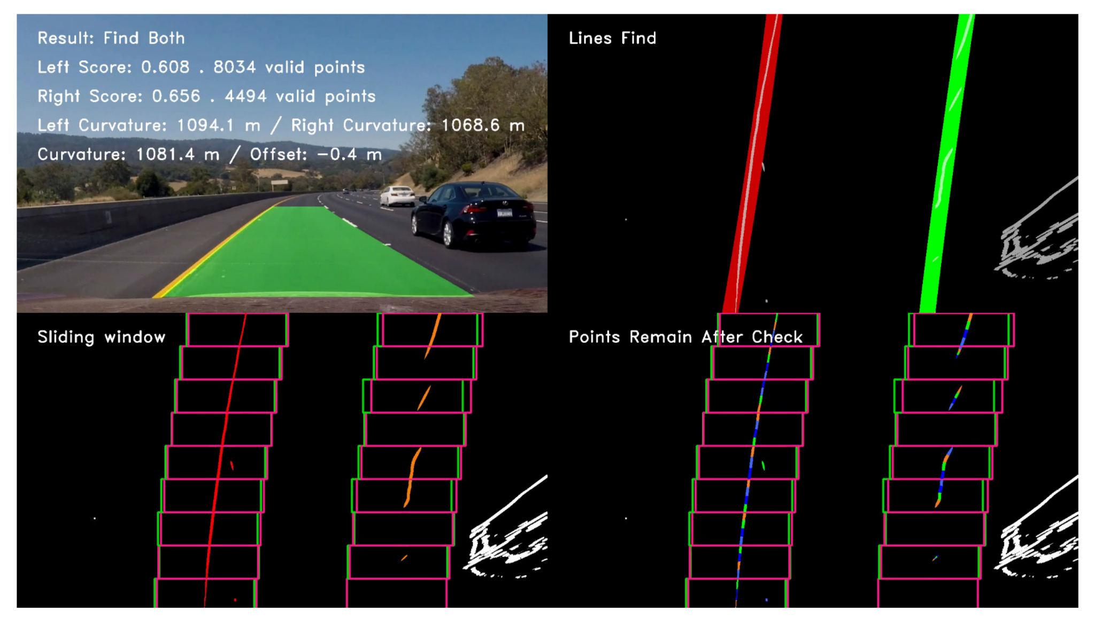
Validation 2:
New pipeline we built actually works as intended
ROS sent images to Hybrid Net
Hybrid Net received unaltered images
Hybrid Net performs correct Lane & Object Detection
Hybrid Net sends final images back to ROS
ROS receives unaltered images
Notes:
Pavan

Slide 28
9
Economic Analysis and Budget
Notes:
Viet

Slide 29



Item | Cost
External Hard drive | 50$ - 100$ depending on how big of files we need and such like datasets
Human Labour
Notes:
Viet

Slide 30
10
Schedule of Tasks
Notes:
Jason

Slide 31
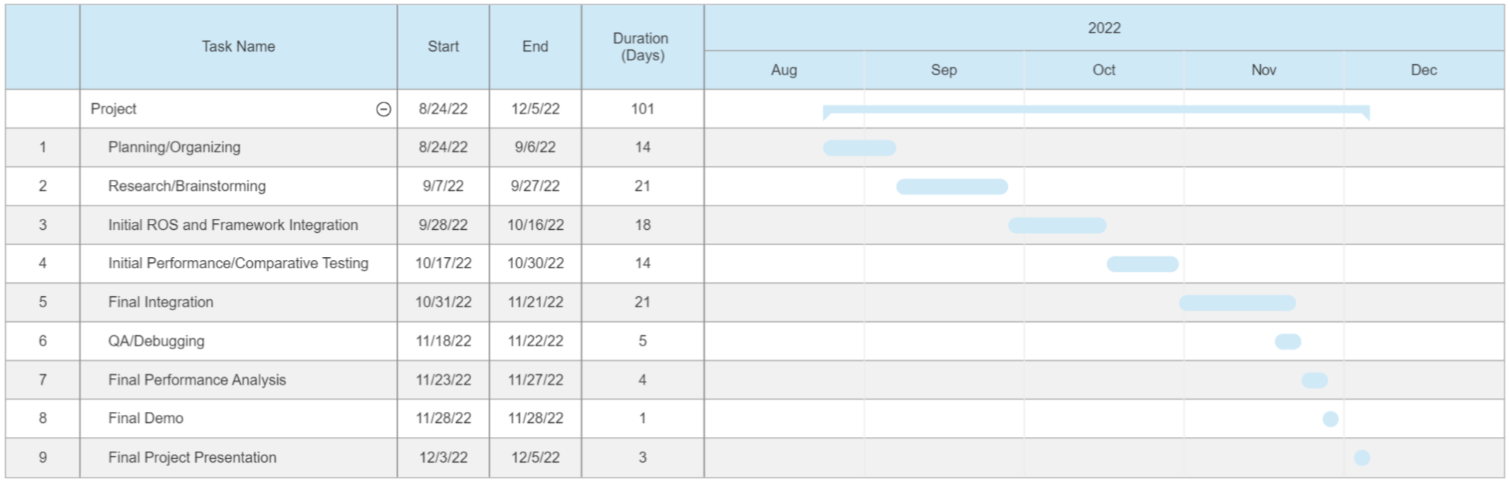
Gantt Chart of Tasks
Note: Estimation for time of completion, subject to change
Notes:
Jason

Slide 32
11
Project Management and Teamwork
Notes:
Jason

Slide 33
Team Roles
Jason Bernal - Team Leader
Khai Nguyen - System Design
Viet Nguyen - QA/Validation
Pavan Poladi - Software Design
Weekly meetings
Weekly objectives/goals
Weekly progress updates
Team is very collaborative and so we often interchange responsibilities.
Notes:
Jason

Slide 34
12
Societal, Safety, and Environmental Analysis
Notes:
Viet

Slide 35

Economic viability
Cars are a crucial part of modern life for us, and they are prevalent nearly everywhere
Autonomous cars has the extra appeal of being hybrid and electric cars
High demand - up to $70,000 for certain used electric vehicles
High upfront costs
Possible tax credits
Electric can save costs!
Notes:
Viet

Slide 36



Sustainability
Regulations
laws on accuracy to be street legal
Flow of Time
Better hardware, software, and technology comes
with time
System Parts
mostly just software
Notes:
Viet

Slide 37

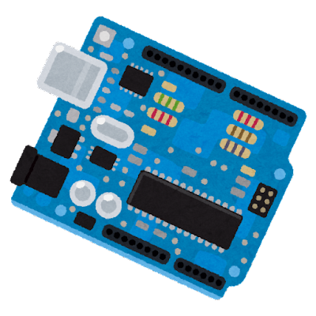

Manufacturing
Component Tolerance
microcontrollers
software version
Production
companies already makes microcontrollers
Testing
accuracy
performance
Notes:
Viet

Slide 38




Trolley (Ethics)
Detection of people and sidewalks
Free Time
Pollution
Less crashes but…
More demand for cars
Higher vehicles traveled per capita
Cars have more uptime in an ideal society
Societal, safety and environmental analysis
Notes:
Viet

Slide 39
Thanks!
ANY QUESTIONS?
Notes:
Jason

